Slide 1

AI BASED ART GALLERY MOBILE APPLICATION​
Advisor
Ayşe Nurdan Saran
Team Members
Batuhan ÖZER 202011072
Mertcan ZAFER 202011076
Tunahan GÜLTEKİN 202011005
Mehmet Emre KILINÇ 202111058
Emre Şahin DEMİRBAŞ 202011020

Slide 2

Contents
Introduction
Main Challenges
Application Comparisons
Specified Requirements
Technological Needs
Application Interactions
Conclusion

Slide 3
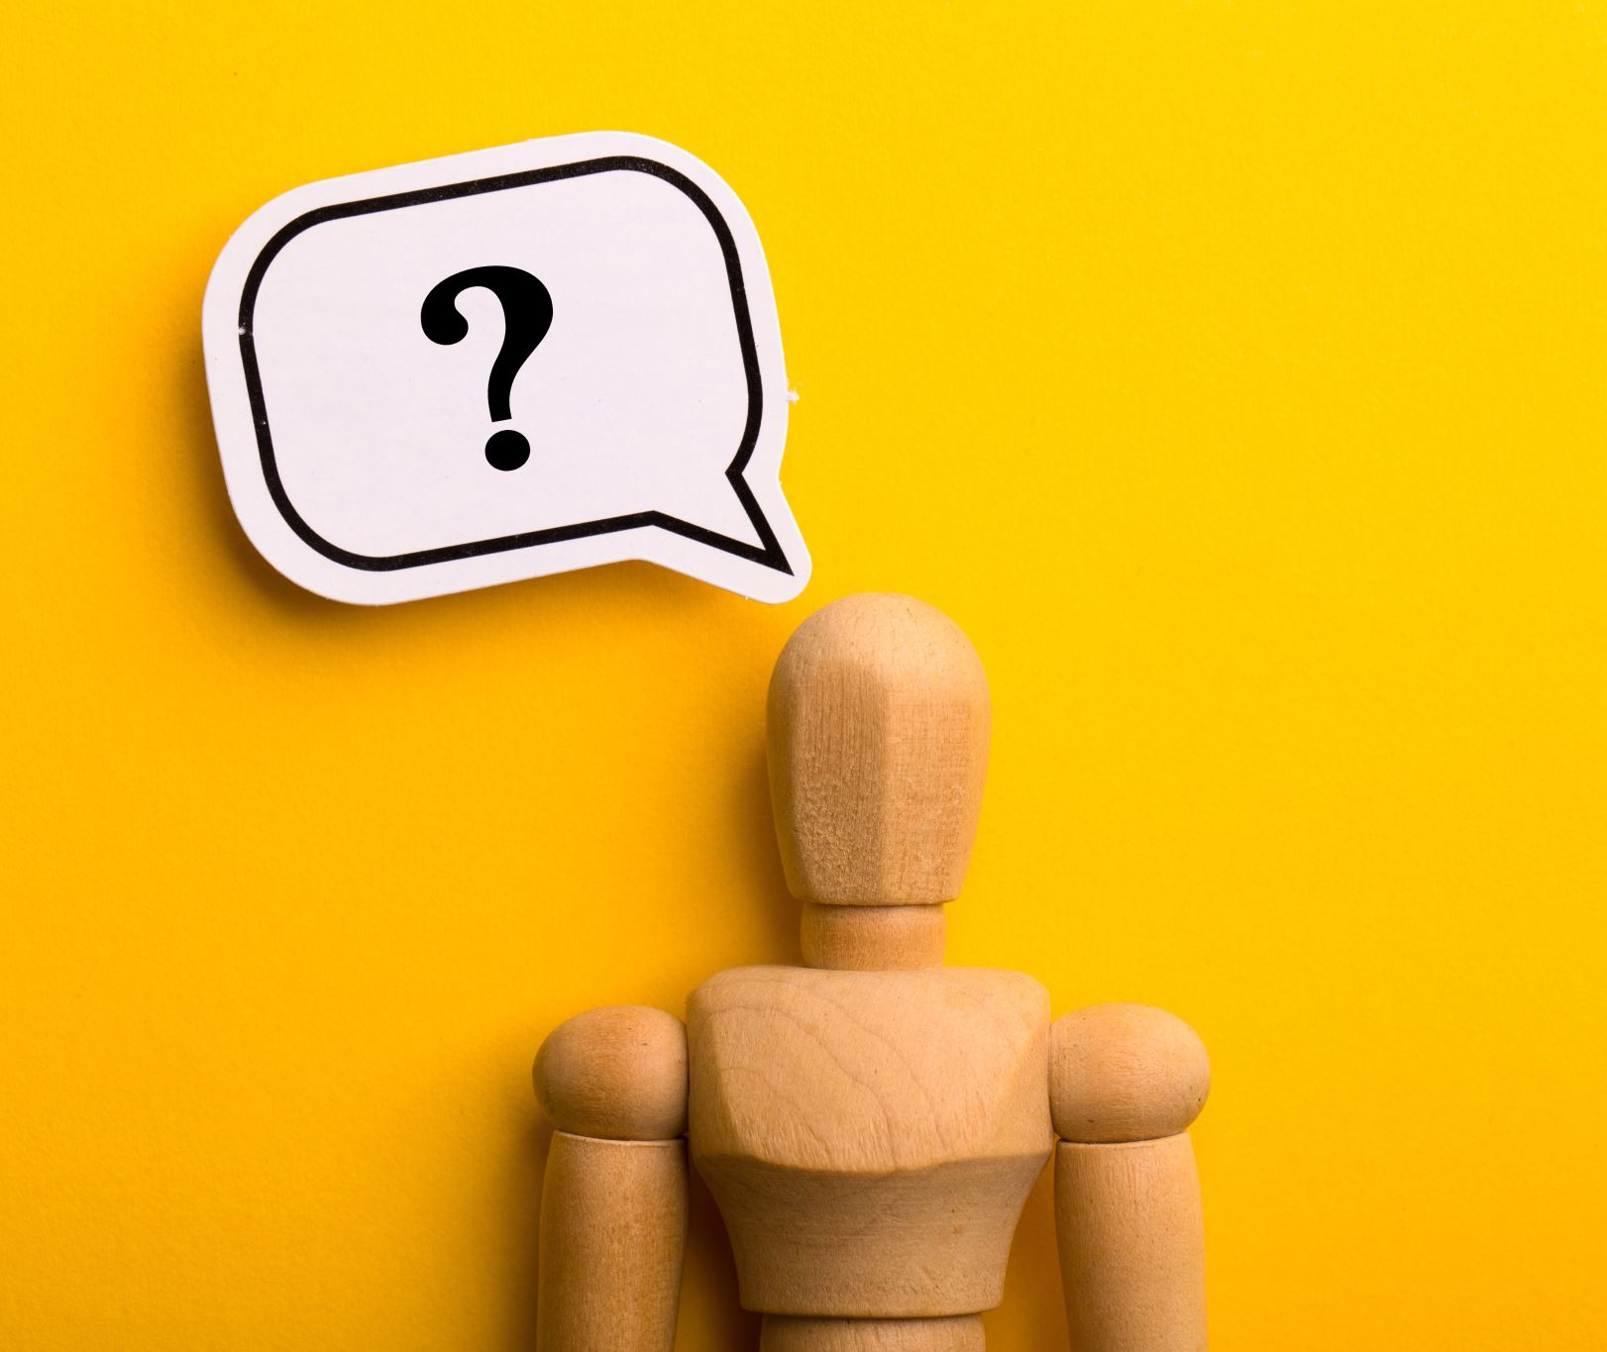
Introduction

Slide 4


Introduction
Today, AI offers innovative solutions across various fields.

Slide 5
Q : Have you ever wanted to feel like an artist without knowing how to paint?

Slide 6
Imagine someone who loves painting but feels they lack talent.

Slide 7
Our Goal
We aim to make these talent-driven experiences, like creating art, accessible to everyone through AI.
Our mission is to democratize the feeling of being an artist and make art a part of everyone’s life, not just for the talented.

Slide 8
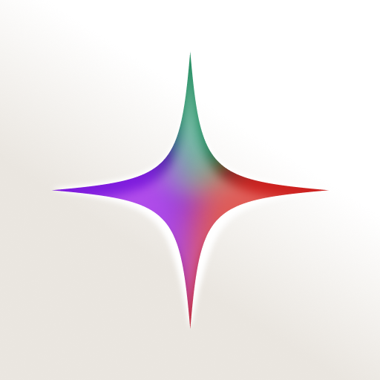

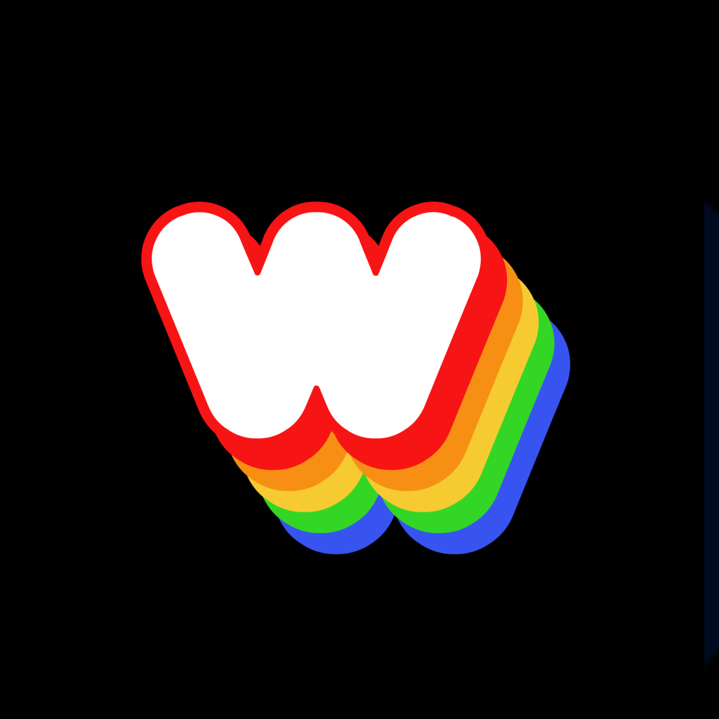
Current State
Existing AI-based art apps do not fully support the feeling of being an artist. These apps only generate images
Starry AI
Davinci
Wombo

Slide 9
Our Solution
To address these gaps, we combine three key features to deliver a complete artist experience:
Art Creation: Users can create their envisioned artworks with AI assistance.​
Story Generation: AI generates a story or meaningful message for the artwork.​
Showcasing and Sharing Art: Users can exhibit their creations in a virtual gallery and share them with others.

Slide 10

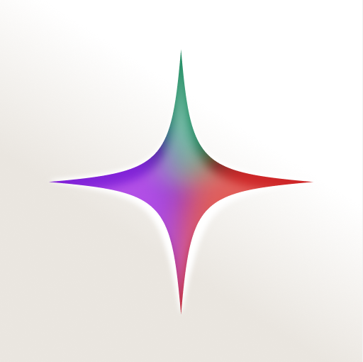
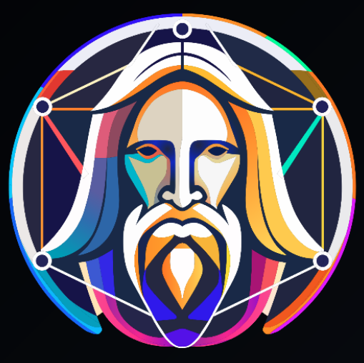
Research & Feature Analysis
Gencraft AI
Starry AI
Leonardo AI

Slide 11
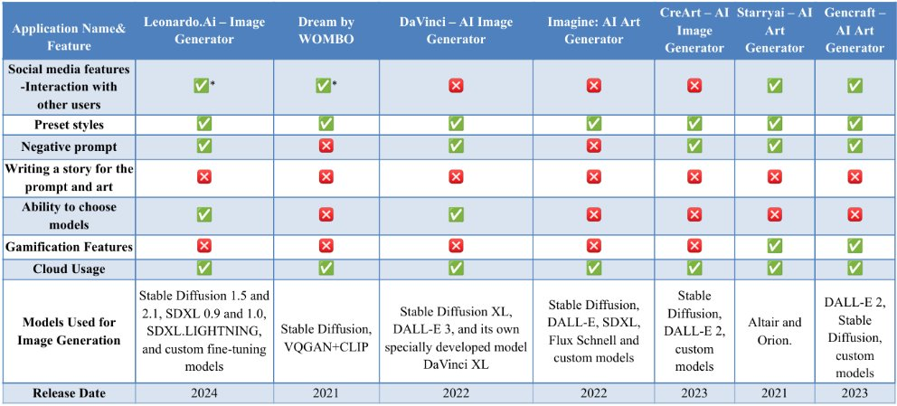
Strengths and Weaknesses of Existing Applications

Slide 12
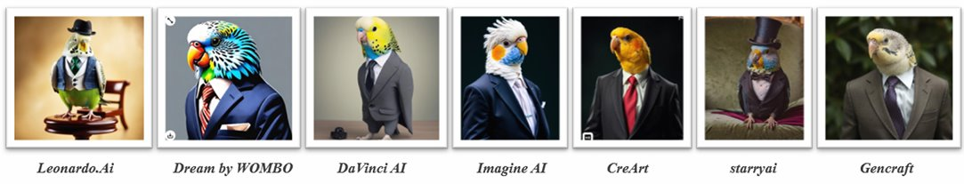
Strengths and Weaknesses of Existing Applications

Slide 13
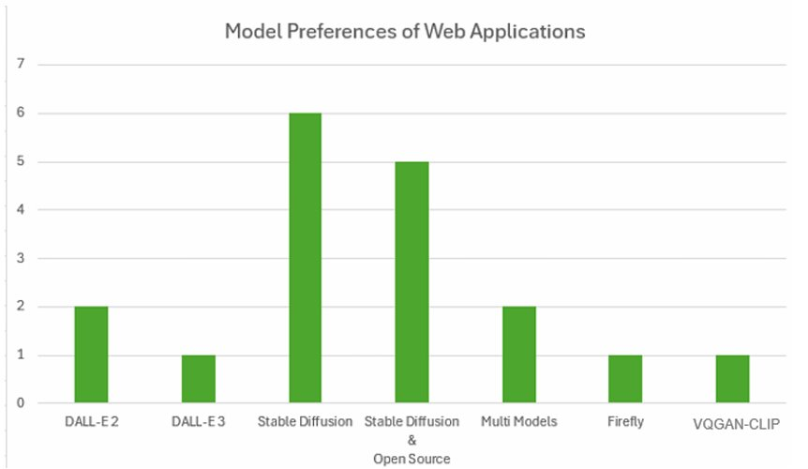
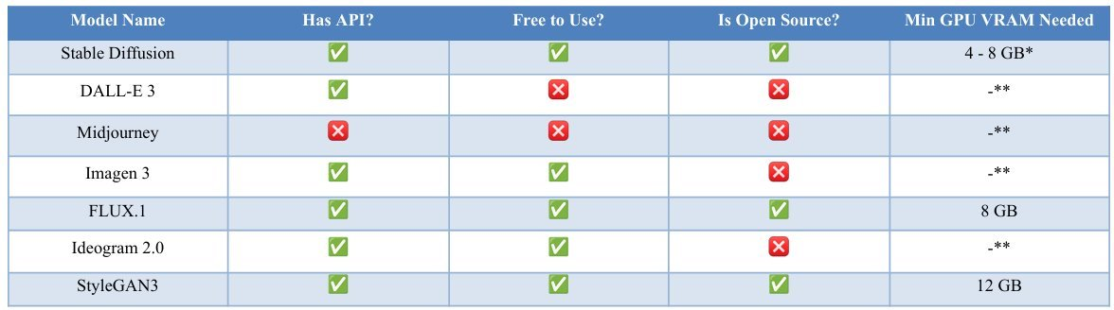
Strengths and Weaknesses of Existing Applications

Slide 14
Specified Requirements

Slide 15
Requirements
Login Forget Password Sign Up Like an Artwork Share an Artwork Filter Comment Visit another User’s Profile Follow Another User Homepage navigation Complete achievements More options Search Inspect photo View Notifications Click on Notifications | View challenges View achievements Complete challenges View User’s Own Profile See Follows/Followers List See Comments View User’s Own Previous Artworks Sign out Change password Change color theme Change language Generate Artwork Generate Story Download Share image on your profile Observe search results

Slide 16
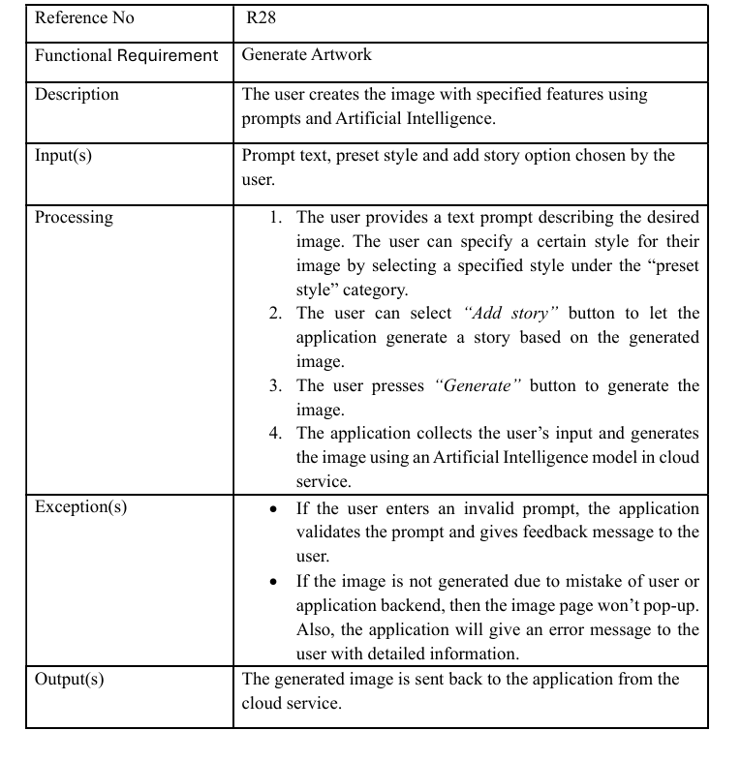
Requirement Template

Slide 17
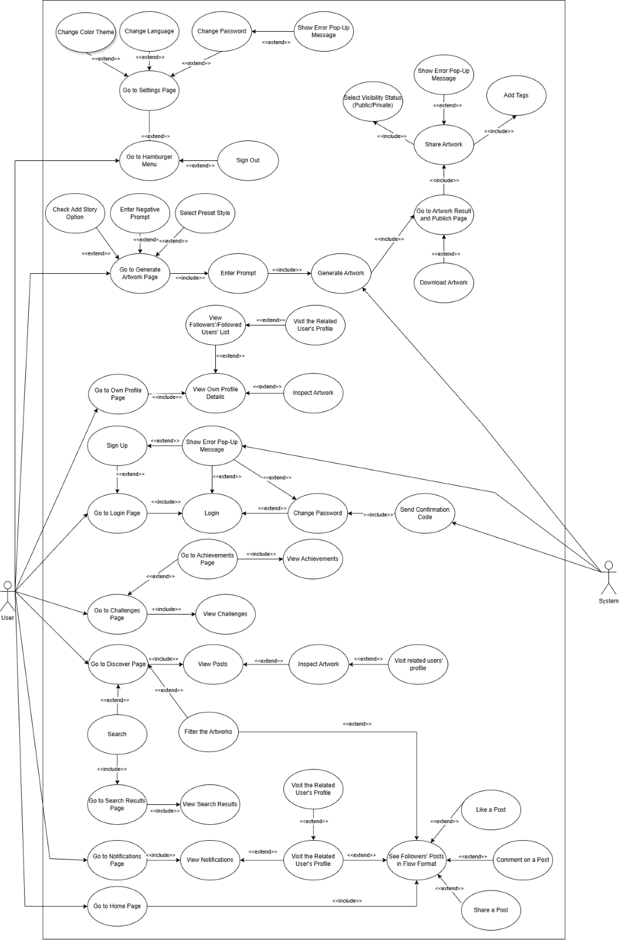
Use Case Diagram

Slide 18
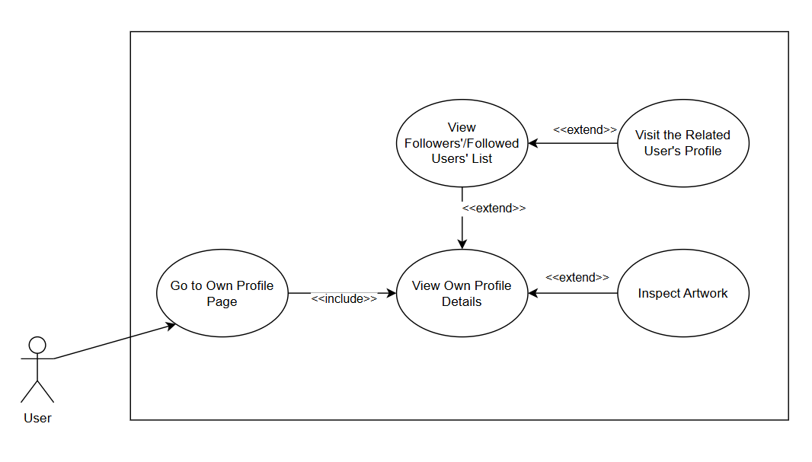
Use Case Diagram Sample

Slide 19
Use Case Sample
Use Case Name: View Notifications
Authors: Emre Şahin Demirbaş
Actors: User
Overview: This use case allows the user to view his/her notifications.
References: R8, R15, R16
Related Use Cases: Go to Notifications Page, Visit the Related User's Profile
Typical Flow Description:
1. The user wants to see his/her notifications.
2. The user navigates to the notifications page.
3. The user observes his/her notifications in list format, could swipe the screen to right see more.
Alternative Flow Description:
2a.
1. The user wants to visit the profile of the user who is related with that notification.
2. The user touches on the respective artwork creator's profile picture.
3. The user views the related user's profile details.

Slide 20





Technological Needs
Development Environment: Android studio
Programming Language: Kotlin, Python
Cloud Platforms: AWS, Microsoft Azure, Google Cloud
Database System: Firebase Storage, Firebase Realtime Database
Libraries and Frameworks: AWS SDK for Kotlin, Hugging Face Transformers, Retrofit or OkHttp, PyTorch, TensorFlow, Keras
Image Generation Model: Stable Diffusion
Story Generation Model: ChatGPT or Gemini

Slide 21
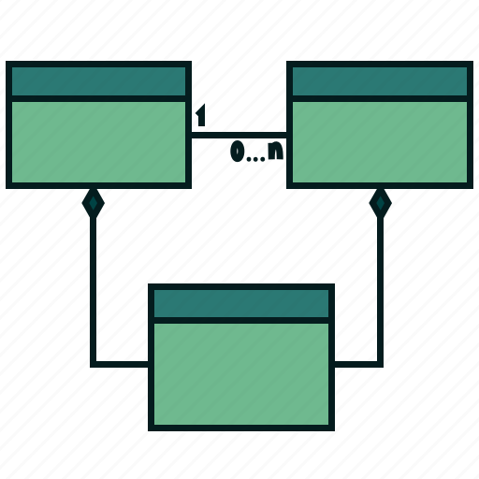
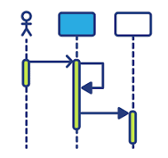
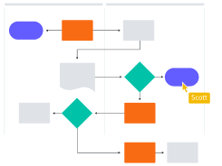
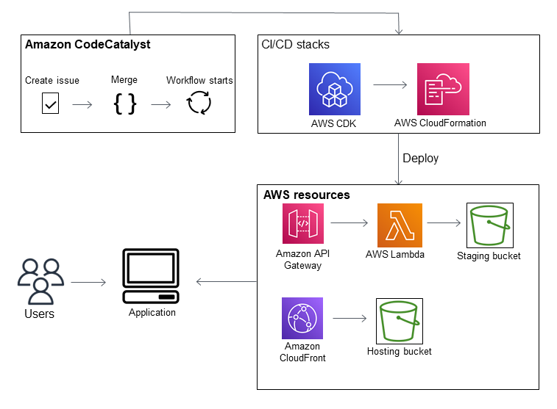
Software Design
ER Diagram ​
Class Diagram ​
Application Interaction ​
Sample Activity & Sequence Diagrams ​

Slide 22
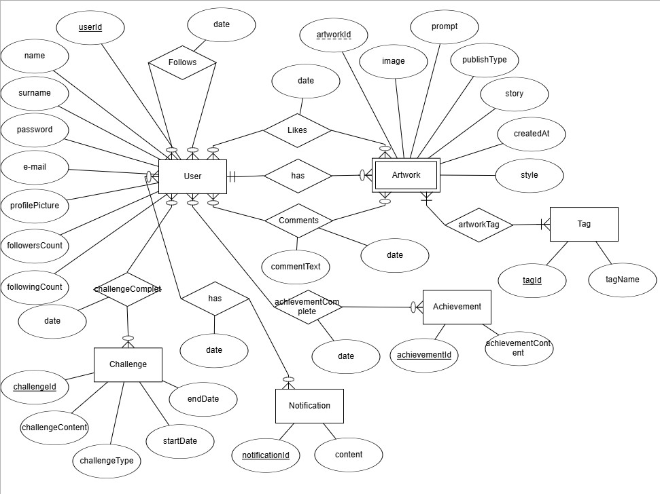
ER Diagram

Slide 23
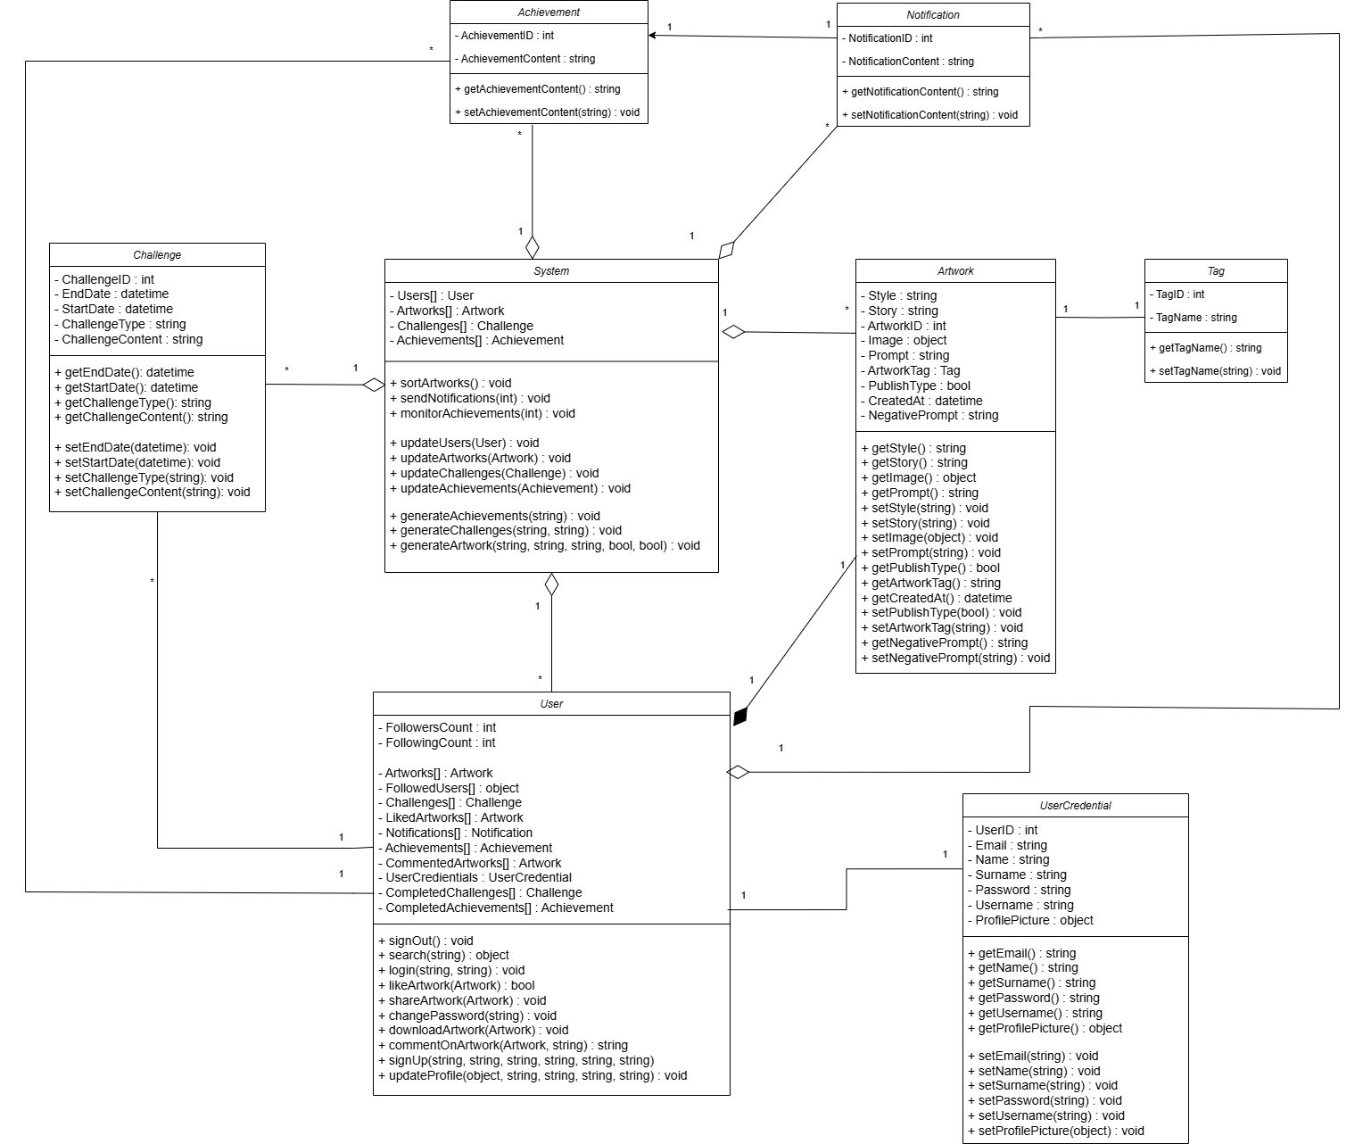
Class Diagram​

Slide 24
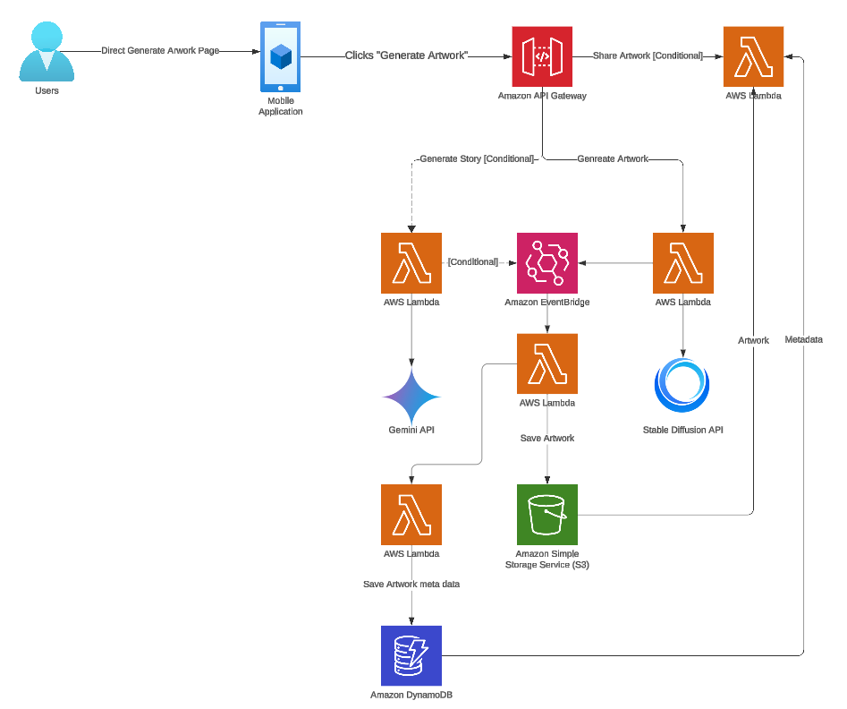
Application Interaction

Slide 25
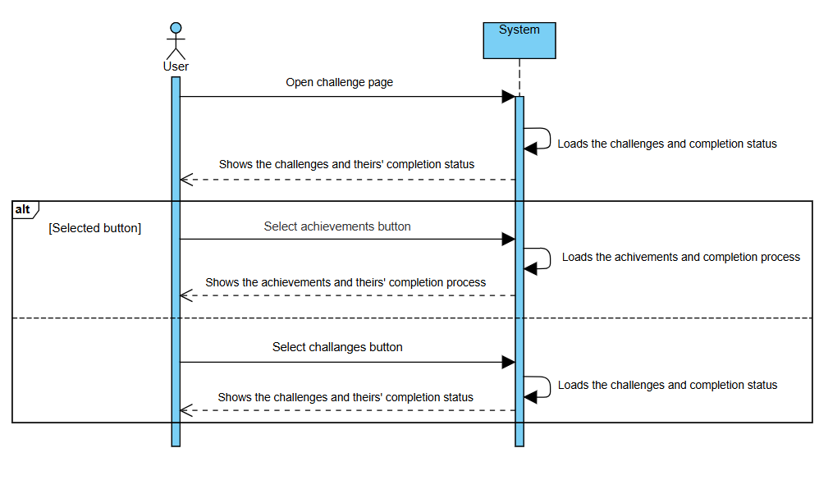
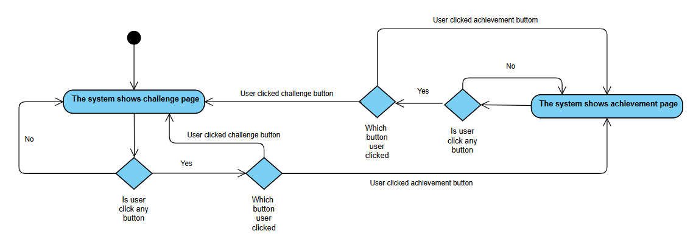
Sample Activity & Sequence Diagrams

Slide 26
User Interface Design

Slide 27
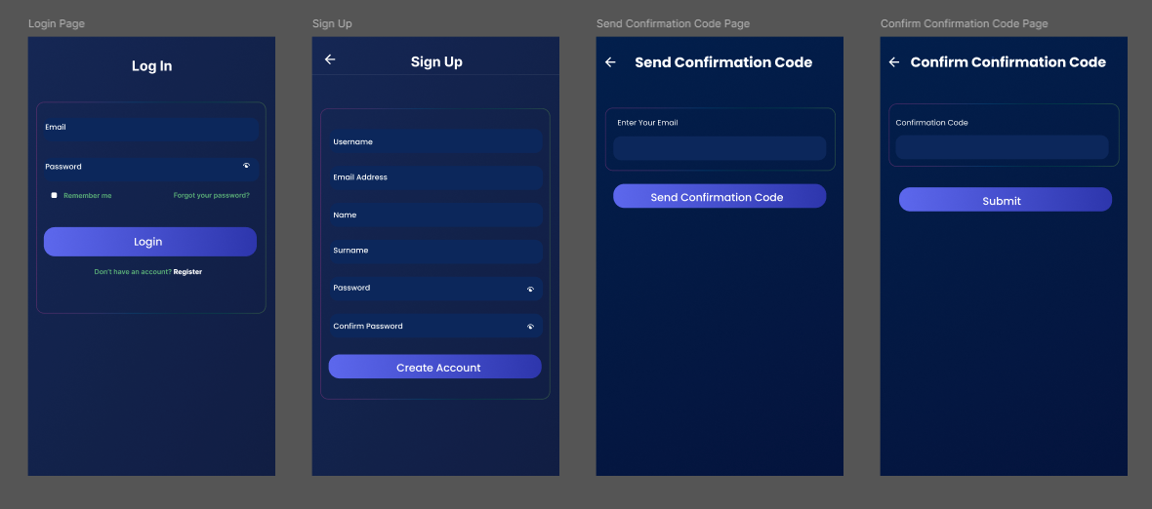
Login Page

Slide 28
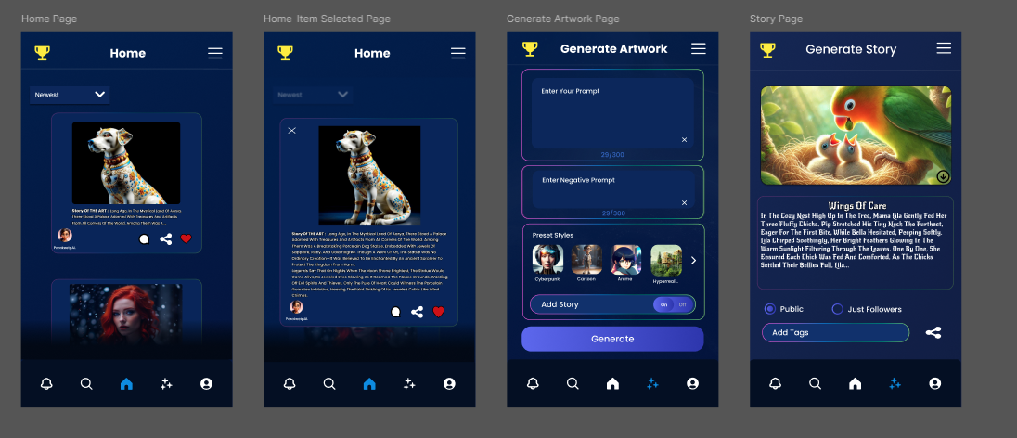
Home and Generate Artwork Pages

Slide 29
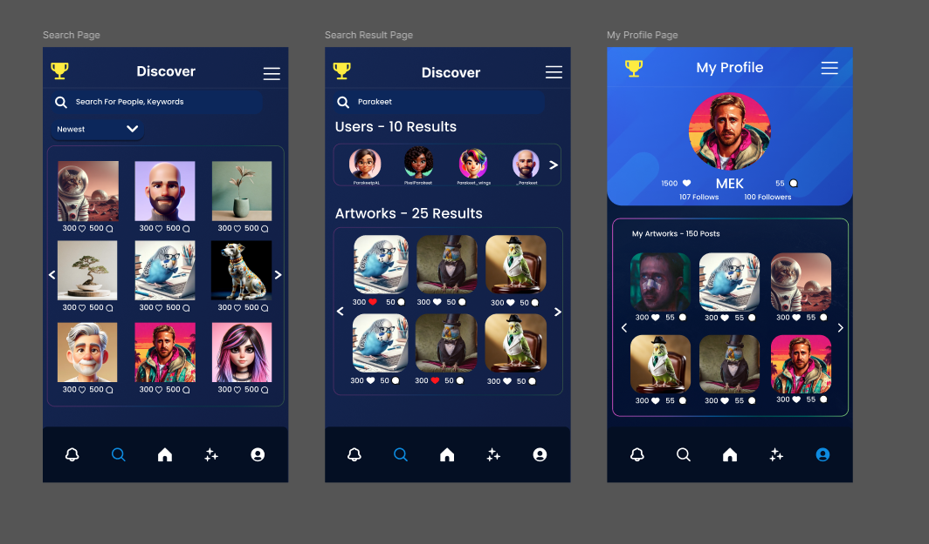
Search Page
Search and Profile Pages

Slide 30
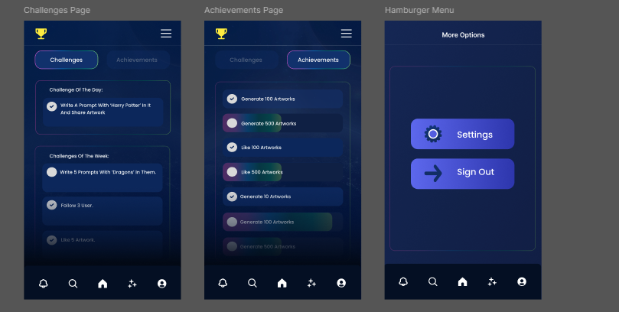
Challenges & Achievements and Hamburger Pages

Slide 31
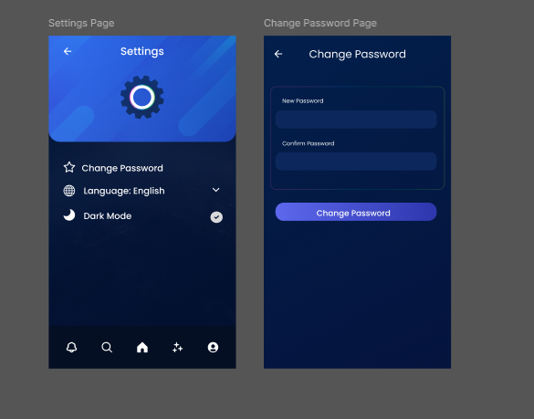
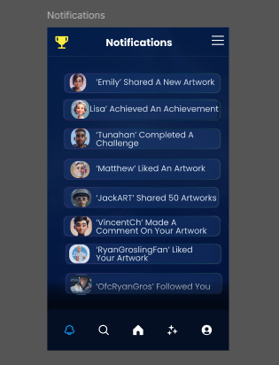
Settings, Change Password and Notifications Pages

Slide 32
Conclusion

Slide 33
Roadmap – Planned Tools & Technologies To Be Used
Programming Language: Kotlin
IDE: Android Studio
Cloud Storage: AWS
Image Generation Model: Stable Diffusion
Story Generation Model: Gemini

Slide 34
Challenges
Lack of previous experience in mobile application development.
Limits and external dependencies in model and cloud usage.
Integration of multiple external systems.

Slide 35
CENG408 Phase Possible Implementation Roadmap
The following possible works (not limited to) could be distributed to the group members:
Designing and implementing the User Interface
Integrating the tools like Gemini to our application
Handling database and cloud storage operations
In the case of using a fine-tuned text-to-image model, handling its optimization and testing operations.

Slide 36

Thank You

